Slide 1
Google Data Analystics Capstone Project: Cyclistic bike-share analysis
Click here for interactive Tableau Dashboard

Slide 2
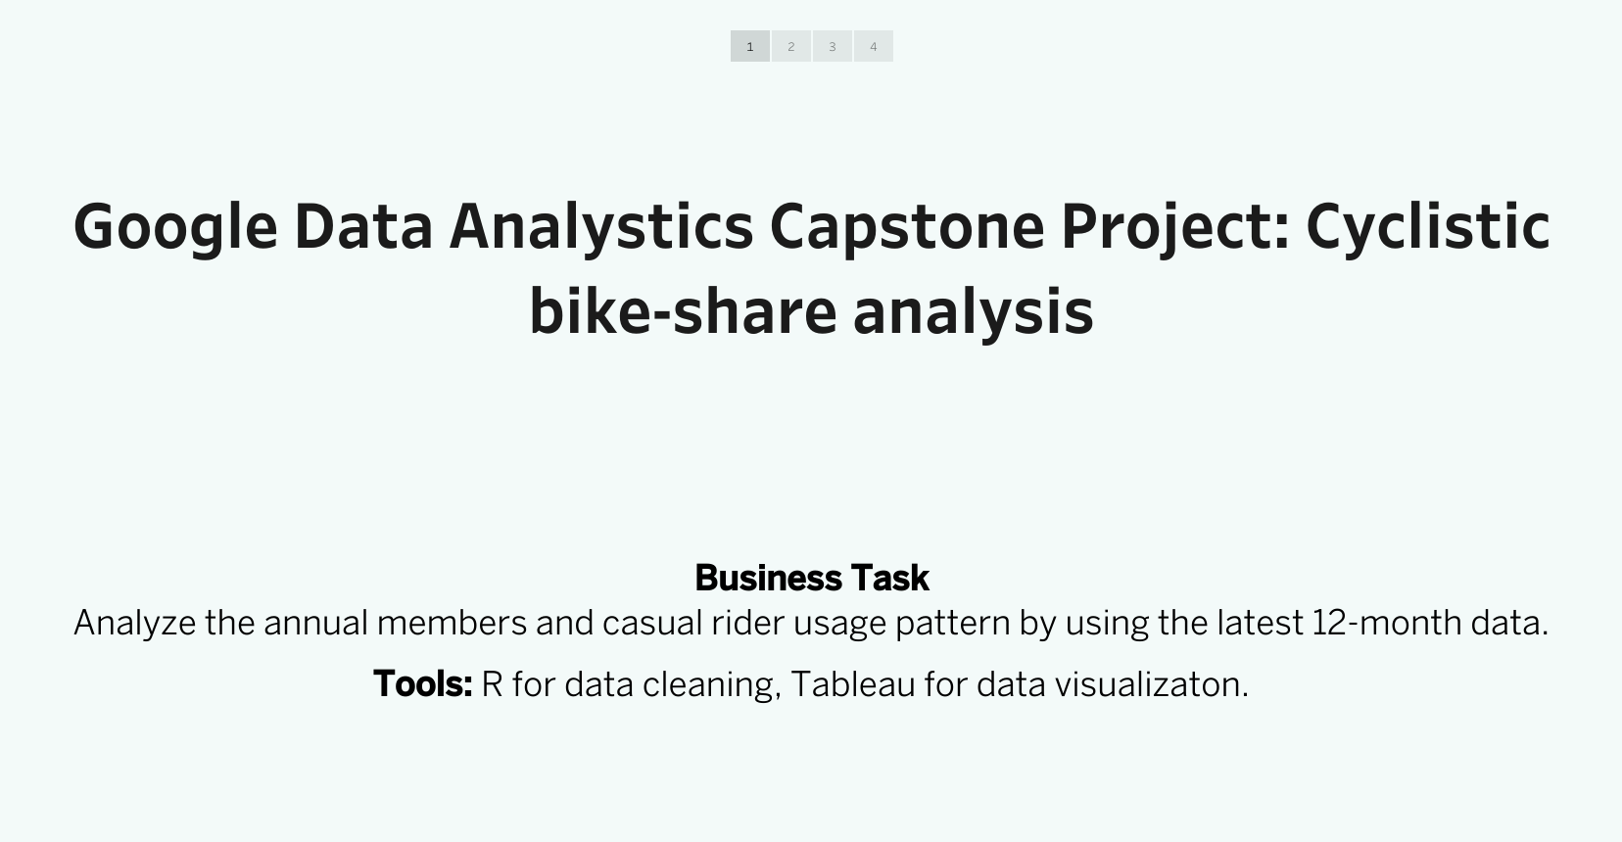

Slide 3
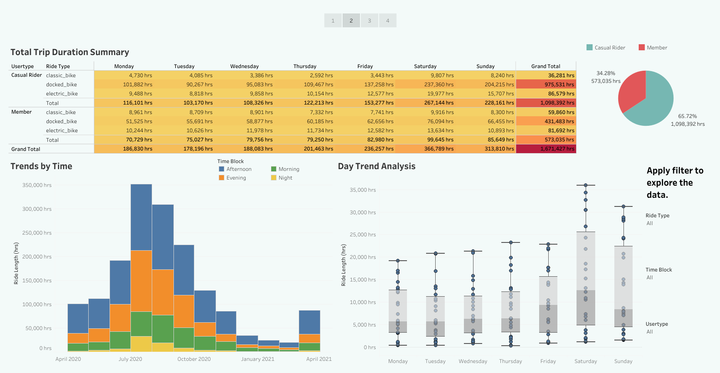

Slide 4
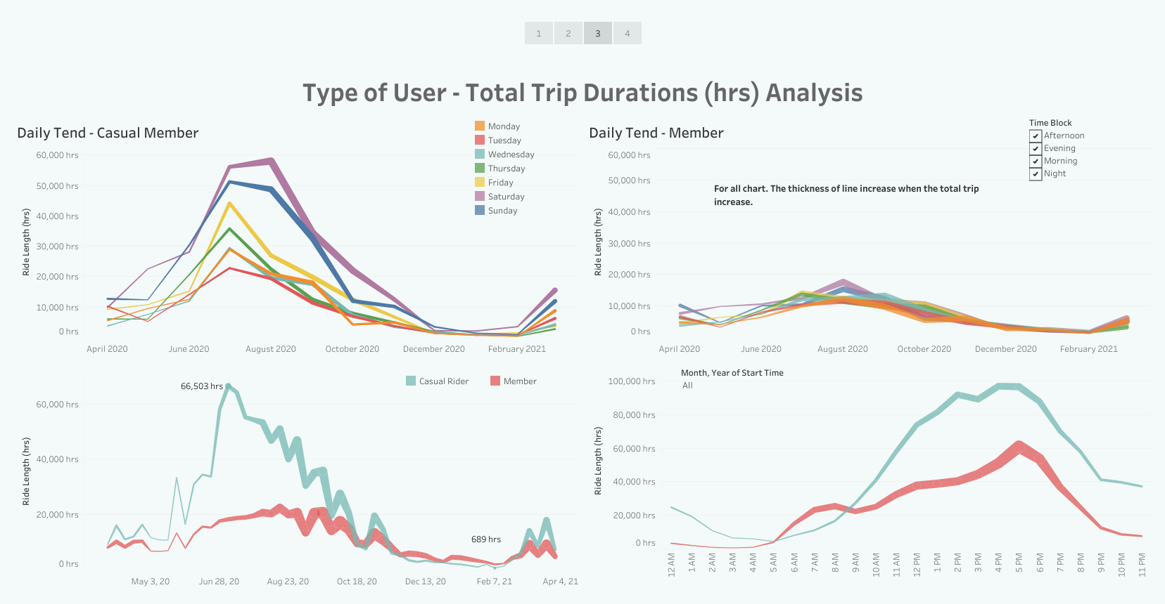

Slide 5
